Slide 1

Department of information technology abes engineering college ,ghaziabad
MINI PROJECT PRESENTATION (P1)
SESSIONS 2022-23
(LANGUAGE TRANSLATOR)
Team member
1)ABHINAV CHAUDHARY 2)ABHINAV GUPTA
3)ADARSH JAISWAL

Slide 2
CONTENTS:.
1)ABOUT THE TRAINING DOMAIN
2)OBJECTVE OF DOMAIN COURSE
3)PROJECT BASED LEARNING
UNDER THE DOMAIN COURSE
4)CHALLENGES AND LIMITATION OF PROJECT
5)CONCLUSION
ANNEXURES:
A CODE SNIPPETS
B PROJECT DEMO SNIPPETS

Slide 3
1)About the training domain (DATA SCIENCE)
In data science ,the term domain knowledge is used to refer to the general background knowledge of the field or environment to which the method of data science being applied
Data science ,as a discipline ,can be thought of as the study of tools used to model data, and make decision on data.
They are generic tools applicable to many fields like engineering, laws etc

Slide 4
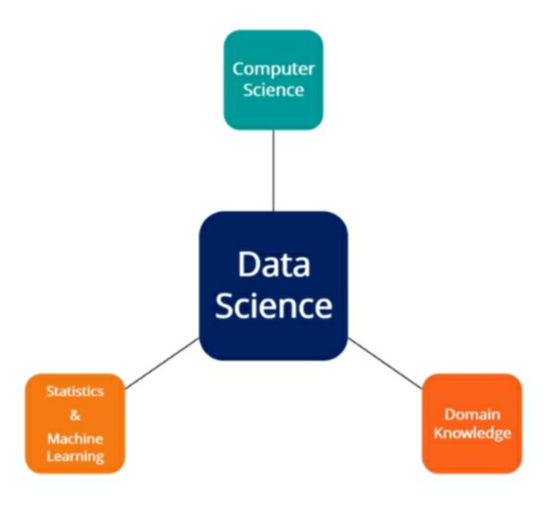
BLOCK DIAGRAM

Slide 5
Data Science Subject Areas
Computer science and programming: It refers to study of computational tools like programming language , software etc.
Statistics and Machine Learning: Statistics and machine learning from the theoretical foundation of data science methods and algorithms.
Domain Knowledge: is often referred to as a general discipline or fields to which data science is applied to.

Slide 6
2)Objective of Training Domain: DATA SCIENCE
Used to assists minimize costs.
Discover new markets and make better decision.
Data science technique are incredible at spotting abnormalities, predicting and targeting

Slide 7
.
Obtaining data
Cleaning or Scrubbing data
Visualizing and Exploring data will allows us to find patterns and trends
Modelling data will give us our predictive power as a data magicians
Interpreting data

Slide 8
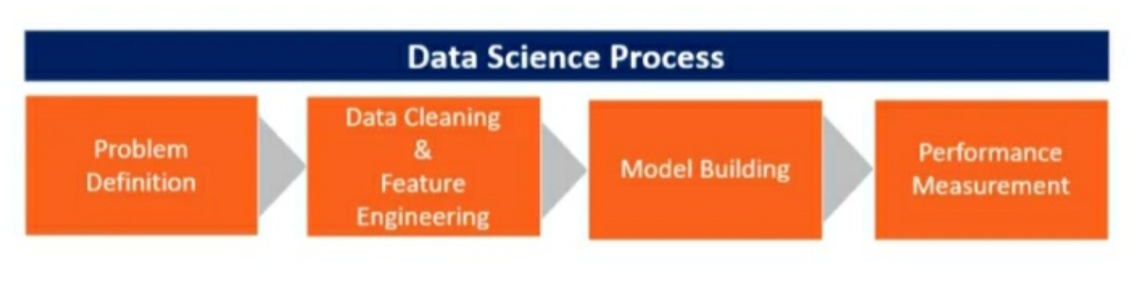
.

Slide 9
Projects based learning under the domain course
1)Deep learning: It is a subset of machine learning which is essentially a neural network.
Deep learning drives many artificial intelligence application and services that
improves automation performing analytics.
2)Machine learning: Artificial intelligence system are used to perform complex tasks in a way that is similar to how to solve human problems.
As the capability of a machine to imitate intelligent human behaviour .

Slide 10
Challenges and Limitations of Projects:
1)Inconsistency in the Level of Accuracy: Dealing with same language in different translator may give the different answer.
2) Costly Mistake: Translator is likely to make mistakes at times ,like giving faulty translation or accidently altering the final message in minor ways.

Slide 11
.
3) Slow speed: On an average translator can translate 1000-1500 words in a day. If we consider a books of 10000 words it takes 10 days.
4)Time and Resource to find the Right Resource : Finding a good translator may be has its own challenges.

Slide 12
Conclusion:
A professional language translator helps eliminate the barriers imposed by unfamiliar languages .
Allows us to communicate directly with your foreign audience without the fear of distorting the original messages meaning.
As in coming future we see that company demanding for data scientist for to analyse ,predicts huge amounts of data.

Slide 13


Slide 14
